Slide 1
Face-Mic: inferring live speech and speaker identity via subtle facial dynamics captured by AR/VR motion sensors
Presented by
Zhengkun Ye
Notes:
I am going to introduce this research article on security vulnerabilities and defenses in emerging mobile applications, including augmented reality/virtual reality, and voice assistant systems.

Slide 2
About the Paper
Rutgers researchers have published the first work examining how hackers could use popular virtual reality headsets to steal sensitive information communicated via voice-command, including credit card data and passwords.
“Face-Mic,” the first work examining how voice command features on virtual reality headsets could lead to major privacy leakages, known as “eavesdropping attacks.”
The study was presented at the annual International Conference on Mobile Computing and Networking in March.

Slide 3
Abstract
Augmented reality/virtual reality (AR/VR) has extended beyond 3D immersive gaming to a broader array of applications, such as shopping, tourism, education.
The authors present a serious privacy risk of using voice interfaces while the user is wearing the face-mounted AR/VR devices
An eavesdropping attack, Face-Mic, which leverages speech-associated subtle facial dynamics captured by zero-permission motion sensors in AR/VR headsets to infer highly sensitive information from live human speech, including speaker gender, identity, and speech content.
Face-Mic is grounded on a key insight that AR/VR headsets are closely mounted on the user’s face, allowing a potentially malicious app on the headset to capture underlying facial dynamics as the wearer speaks, including movements of facial muscles and bone-borne vibrations, which encode private biometrics and speech characteristics.
Notes:
How presentation will benefit audience: Adult learners are more interested in a subject if they know how or why it is important to them.
Presenter’s level of expertise in the subject: Briefly state your credentials in this area or explain why participants should listen to you.

Slide 4
Introduction
The authors develops a signal source separation technique to identify and separate the speech-associated facial dynamics from other types of body movements.
The authors extract representative features with respect to the two types of facial dynamics.
They successfully demonstrate the privacy leakage through AR/VR headsets by deriving the user’s gender/identity and extracting speech information via the development of a deep learning-based framework.
The authors implements extensive experiments using four mainstream VR headsets validate the generalizability, effectiveness, and high accuracy of Face-Mic.
Notes:
How presentation will benefit audience: Adult learners are more interested in a subject if they know how or why it is important to them.
Presenter’s level of expertise in the subject: Briefly state your credentials in this area or explain why participants should listen to you.

Slide 5
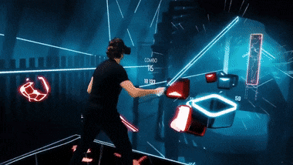


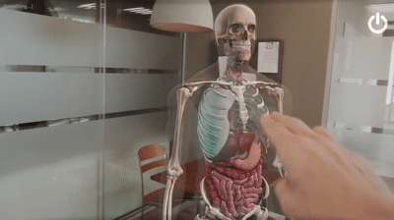
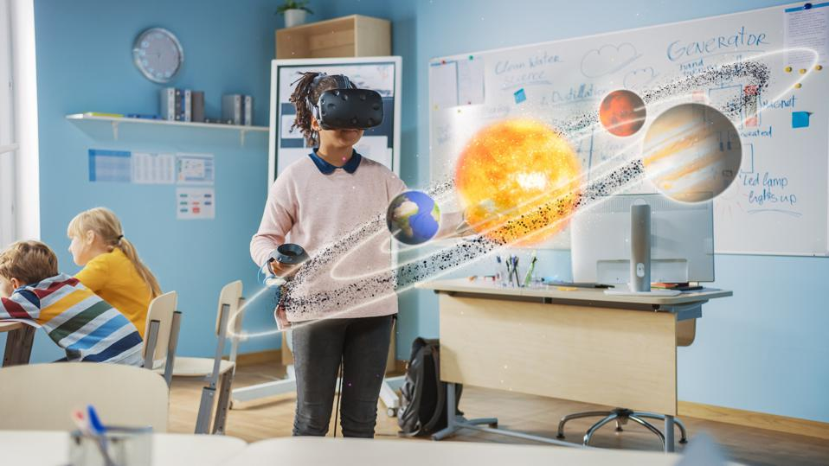
Emerging Face-Mounted AR/VR Devices
Augmented reality/virtual reality (AR/VR) devices have attracted millions of users
Such a rapid expansion facilitates a broad array of emerging AR/VR applications
The control logic of AR/VR devices has been largely shifting towards headset-dominated interaction via voice interface
Notes:
With the capability of creating 3D virtual worlds, where users can immerse in and interact with, augmented reality/virtual reality devices have attracted millions of users. The market size is expected to reach 12 billion dollars in the next two years.
The rapid expansion of face-mounted devices facilitates a broad array of emerging applications, such as immersive gaming, virtual shopping, banking, healthcare, and education.
As the AR/VR domain extends beyond gaming, the control logic of AR/VR devices has been largely shifting from controller-dominated interactions towards headset-dominated interactions via voice user interfaces.

Slide 6


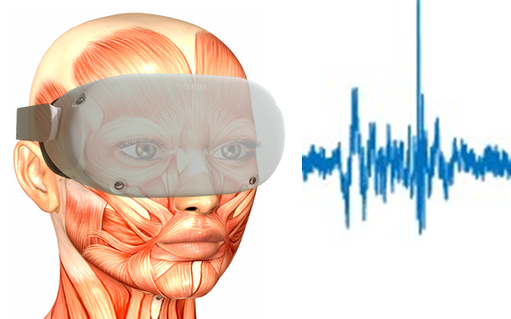


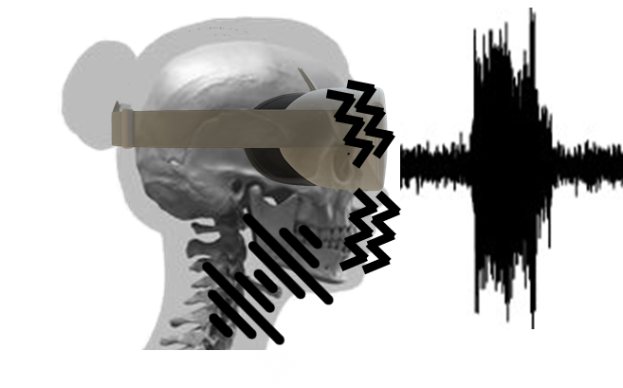
Speech-induced Facial Vibrations
The AR/VR headset is closely mounted on the user’s face, and thus it can capture facial vibrations caused by speech
Eavesdropping attacks via built-in zero-permission AR/VR motion sensors
Speech-induced Facial Vibrations
Notes:
In AR/VR scenarios, the headset is closely mounted on the user’s head and presses different parts of the face. The authors find that such a unique and fundamental characteristic makes the headset susceptible to the facial vibrations caused by human speech, which are embedded with rich speech and speaker characteristics.
Based on this key insight, the authors explore using built-in AR/VR motion sensors including accelerometers and gyroscopes for eavesdropping attacks. Accessing these built-in motion sensors usually does not require user permission, since almost all AR/VR applications need to utilize the motion sensors to track the user’s head motions and simulate the corresponding movements in the virtual environment.

Slide 7
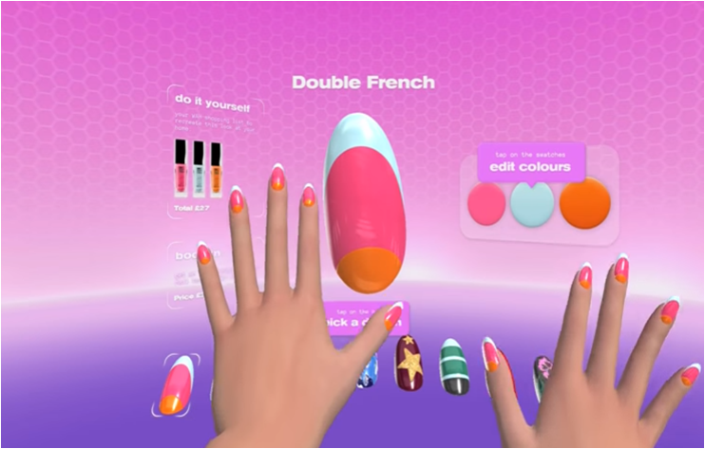
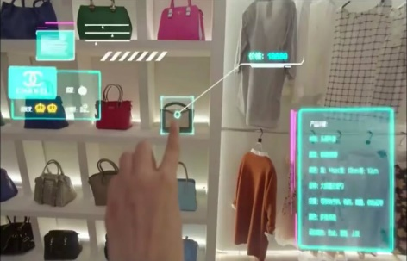
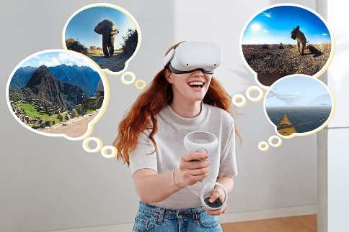


Exploiting Facial Vibration Leakage: Gender and Speaker Info
Leaking identity of the wearer
Watching/shopping preferences
AR/VR travel histories
App usage
Leaking gender information of the wearer
Advertising gender-specific products
Analyzing gender-specific behaviors
Notes:
The authors found that the facial vibrations can reveal private information associated with the wearer’s identity, which can be used to infer watching/shopping preferences, AR/VR travel histories, and App usage behaviors.
At the same time, facial vibrations can be used to detect the gender of the victim, for advertising gender-specific products or analyzing gender-specific behaviors without the user’s permission.

Slide 8




Exploiting Facial Vibration Leakage: Sensitive Speech Content
Leaking a broad array of sensitive information in speech
Social Security Number (SSN)
Cell Numbers
Password/Pin
Transactions
Healthcare Info
More importantly, facial vibrations can reveal speech content, such as social security numbers, phone numbers, passwords, transactions, and healthcare information. Exposing such information could lead to identity theft, credit card fraud, confidential and healthcare information leakage, which puts the user’s security and privacy at high risk.

Slide 9
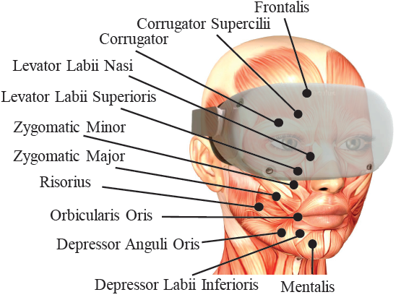
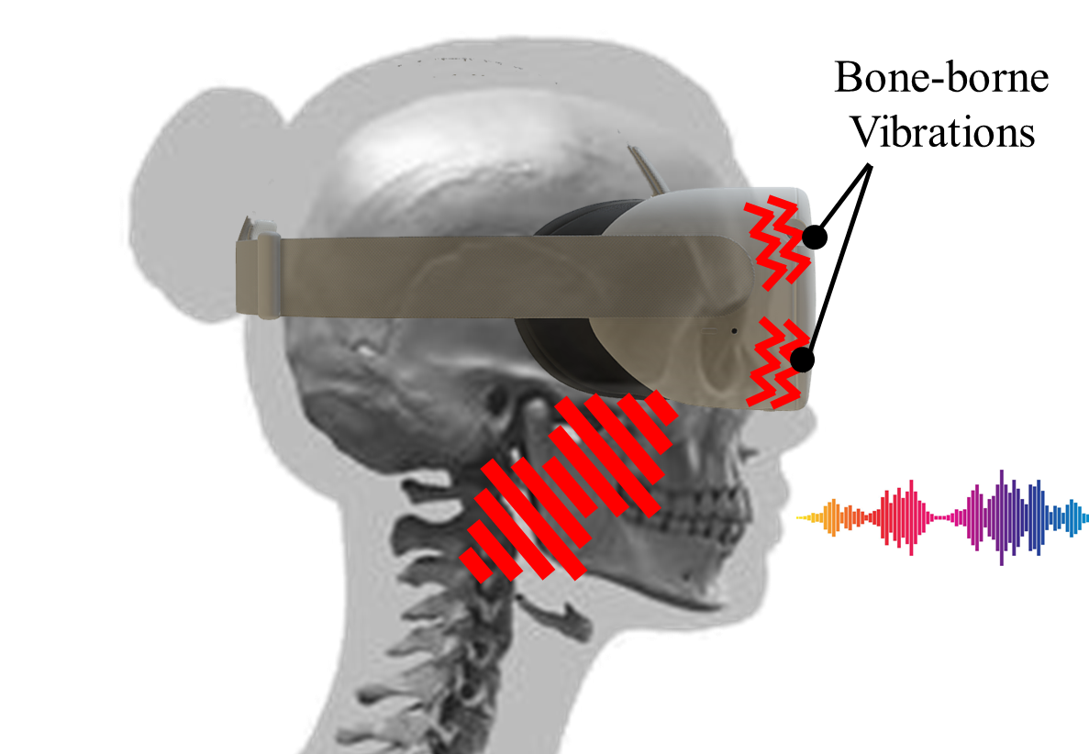
Two Types of Facial Dynamics
Facial muscle movements
Movements of facial muscles during speech
Reflecting speech content and facial biometrics
Bone-borne vibrations
Conductive vibrations produced by vocal cords
Capturing speech and speaker characteristics
Notes:
There are two types of facial vibrations can be captured by AR/VR motion sensors. The headset can be moved or rotated by the dynamics of the underlying facial muscles, which can reflect speech content as well as the wearer’s unique private biometrics, such as the face shape, tissue properties, and behaviors of speaking. We call such dynamics as facial muscle movements.
Furthermore, during the pronunciation of speech, the conductive vibrations produced by the vocal cords can propagate through cranial bones, thereby vibrating the AR/VR headsets. We call such bone-conductive vibrations as bone-borne vibrations.

Slide 10
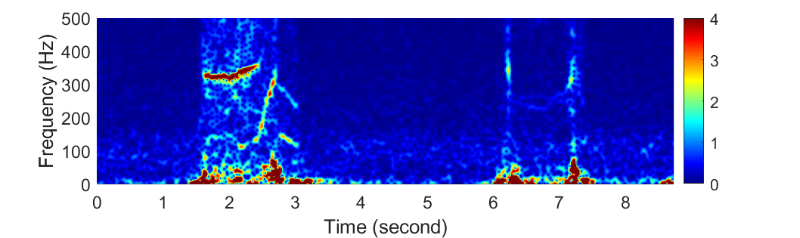
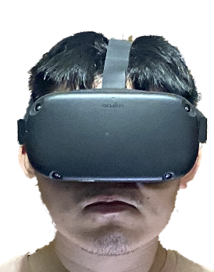
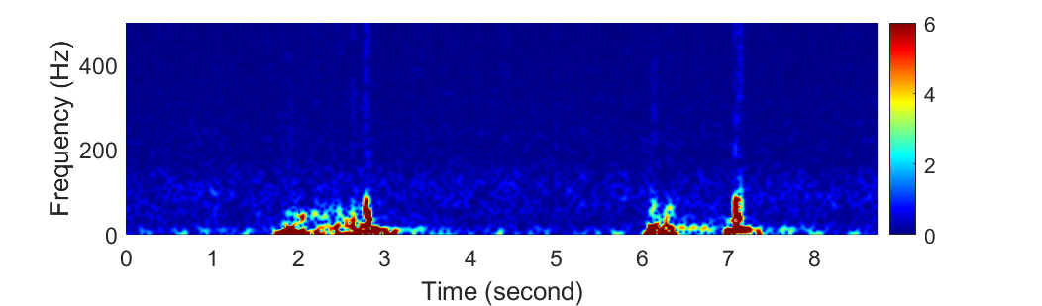
Responses of AR/VR Motion Sensors
Capturing two types of facial vibrations via AR/VR motion sensors
Built-in zero permission accelerometer and a gyroscope
Facial muscle movements influence low-frequency sensor readings, while bone-borne vibrations impact the high-frequency readings
One
Oh
(a) Both facial movements and bone-borne vibrations
One
(<100Hz)
Oh
(<100Hz)
A subject wearing an Oculus Quest headset in the preliminary study
(b) Facial muscle movements only
Notes:
To demonstrate the impacts of the two types of facial vibrations on motion sensor readings, the authors conduct preliminary studies by asking a subject to wear an Oculus Quest headset and speak some simple digits, One and Oh. The built-in accelerometer is used to pick up facial vibrations propagating through the headset. The authors analyze the speech in time-frequency domain through short-time Fourier transformation and find that two types of facial vibrations impact sensor readings across 0~500Hz.
The authors further conduct an experiment by asking the subject to perform facial movements without pronouncing, so that only facial movements are involved. The authors find that the high-frequency responses over 100Hz disappear. These observations show that the facial movements mainly influence the low-frequency motion sensor readings, while the bone-borne vibrations strongly impact the sensor readings at high frequencies.

Slide 11









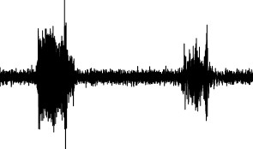




Threat Model
Adversary’s capability and the attack procedure
A malicious app installed on the victim’s AR/VR device (e.g., through posting it on app stores)
The app collects motion sensor data in the background and sends the data to a remote adversary
The adversary exploits learning-based methods to derive the victim’s gender, identity, and speech content
Accelerometer
User Identity
Gender
Gyroscope
Sensor data collection
Speech Content
A malicious app on the victim’s headset
Remote adversary
Notes:
To leverage facial vibrations for the eavesdropping attack, the authors assume the adversary has a malicious app installed on the victim’s AR/VR device, either through fooling the victim to install the app or posting the app on the AR/VR app stores.
The malicious app collects motion sensor data in the background and sends the data to the remote adversary. Their study on two mainstream AR/VR programming platforms, including Oculus and OpenVR, show that accessing motion sensor data does not require any permission.
With the sensor data, the adversary can apply signal processing and learning-based techniques to reveal the victim's gender, identity, and speech content.

Slide 12
Attack Scenarios and Training Requirements
Scenario-1: attack with prior victim data
Access victim’s label data ahead of time
Recording audio data remotely during AR/VR voice chat
Scenario-2: adaptive training during attack phase
Have a pre-trained model built on other people’s data
Utilize the motion sensor data collected in the attack phase to update the pre-trained model through unsupervised adaptation
Scenario-3: real-time attack without prior victim data
The most challenging attack scenario
Directly use the pre-trained model built on other peoples’ data
Note: since speaker identification needs to have victim’s identity as a priori, we consider this inference task only under Scenario-1

Slide 13
Attack Scenarios and Training Requirements
The authors consider three representative attack scenarios with different training requirements. For the first scenario, the adversary has opportunities to get access to the victim’s motion sensor data and labels ahead of time.
For instance, the adversary may record the victim’s speech audio remotely in some AR/VR scenarios, when the adversary is communicating on a shared audio channel with the victim, such as multi-player AR/VR gaming or virtual meeting.
For the second scenario, the adversary does not have labels for training, but he can perform adaptive training during attack phase.
The authors assume the adversary has a pre-trained model built on other people’s data. During the attack, the motion sensor data of the victim will be utilized to update the parameters of the pre-trained model through unsupervised adaptation, making the model better fit the victim’s facial features.
For the third scenario, the adversary intends to launch the attack in a real-time fashion. This is the most challenging attack scenario.
Once the victim’s motion sensor data is collected, the adversary will directly use the pre-trained model built on other people’s data to perform the inference tasks.

Slide 14
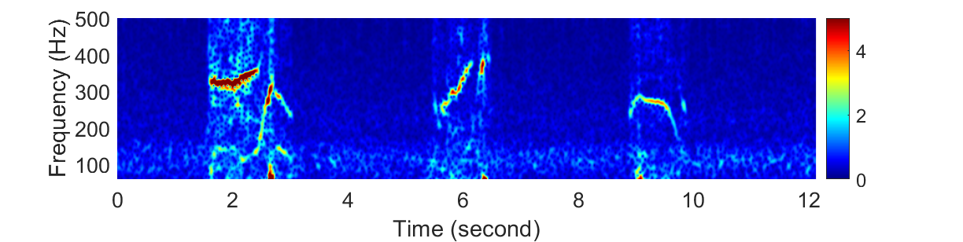
Speech Detection and Segmentation
Leveraging high-frequency bone-borne vibrations to detect speech
Bone-borne vibrations only present during speech pronunciation
Sum accelerometer spectrograms of three axes over 100Hz, and leverage a threshold-based method for segmentation
(a) Summed spectrogram on x, y, z axes of the accelerometer
(b) Accumulated spectrogram energy over 100Hz
Notes:
To conduct a practical eavesdropping attack, the authors first need to detect the presence of human speech based on the motion sensor readings. In AR/VR scenarios, the built-in motion sensor of the headset can capture other body movements, thereby making it very difficult to perform speech detection. To circumvent this issue, the authors leverage the fact that most human body movements usually reside in low-frequency bands. Thus, it is more reliable to detect human speech based on the high-frequency bone-borne vibrations, which are only present during speech pronunciation.
Particularly, the authors calculate the spectrograms of three axes of the accelerometer by applying Short-Time Fast Fourier Transform and conduct element-wise summation on their magnitude. Based on the summed spectrogram. The authors then accumulate the energy across frequencies over 100𝐻𝑧, where the bone-borne vibrations reside, and use a threshold-based method to detect speech.

Slide 15
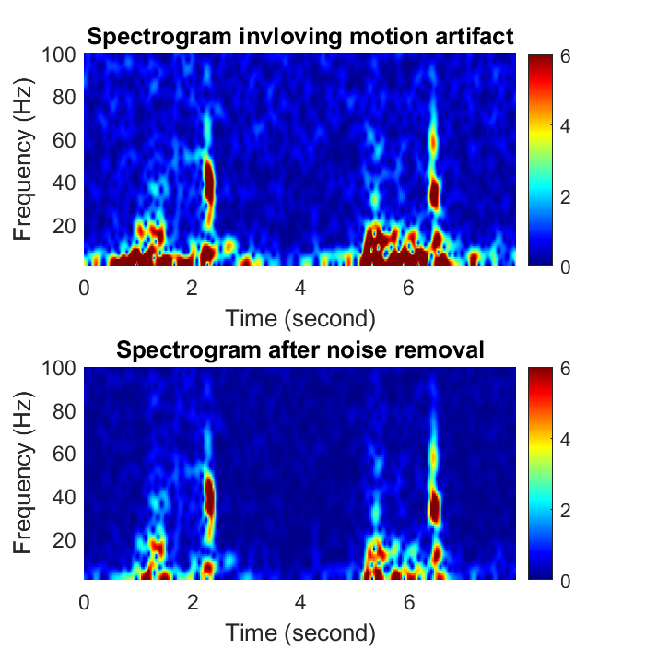
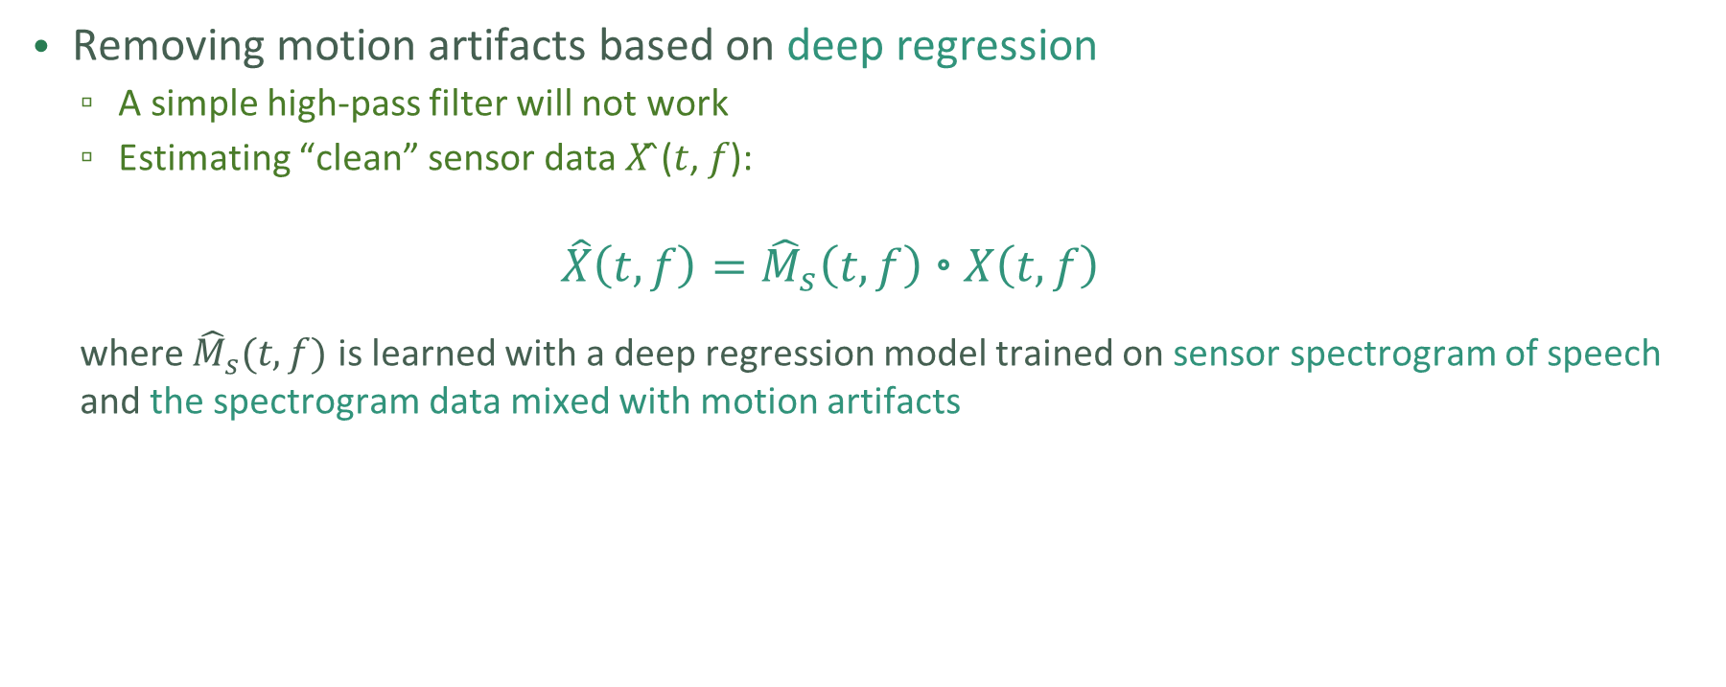


Body Motion Artifact Removal
Removing motion artifacts based on deep regression
A simple high-pass filter will not work
Estimating “clean” sensor data 𝑋 ̂(𝑡, 𝑓):
$$\hat{X}\left(t, f\right)={\hat{M}}_{s}\left(t,f\right)\text{◦}X\left(t,f\right)$$
where ${\hat{M}}_{s}(t,f)$ is learned with a deep regression model trained on sensor spectrogram of speech and the spectrogram data mixed with motion artifacts
Head up and head down
Noisy spectrogram
$$X(t,f)$$
Clean spectrogram
$$\hat{X}\left(t, f\right)$$
Removing the motion artifact entangled in the sensor data
Notes:
To achieve reliable facial vibration extraction, the authors need to remove the motion artifacts contaminating the sensor data. Since human movements normally impact the motion sensor readings at low frequencies, a straight-forward approach is to employ a high-pass filter to remove the low-frequency artifacts. However, finding an optimal cut-off frequency is challenging, since the facial muscle movements are also captured in readings at low frequencies.
The authors model the denoising as a regression problem, which estimates the "clean" motion sensor data based on the noisy readings distorted by human movements. Particularly, they develop deep regression model to estimate a mask, that maps spectrograms with motion artifact into clean spectrogram. To train the deep regression model, they collect motion sensor data of speech and a set of representative body movements without speaking, separately, and then mix them to generate the training data. The sensor data of speech is used as the target regression variables.

Slide 16
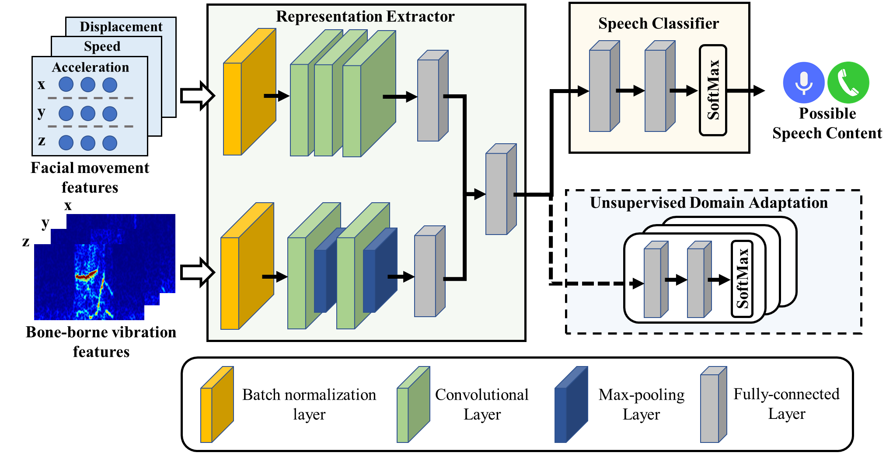
Speech Recognition
Classifying speech content
It is a vary challenging task due to speaker-dependent characteristics
Training a speech recognizer if labeled data (audio data) is available
Applying unsupervised domain adaptation on the motion sensor data collected during the attack if labeled data is not available – removing speaker dependent characteristic
Notes:
Compared to gender detection and speaker identification, recognizing speech content is very challenging due to rich speaker-dependent characteristics embedded in the facial vibrations, especially in some scenarios where data labels are not available. If the victim’s motion sensor data and labels can be obtained ahead of time, their attack correlates the motion sensor data and the labels to train the CNN model for speech recognition.
Otherwise, they utilize the victim’s motion sensor data collected during the attack phase to adapt a pre-trained CNN model built on other people to the victim’s feature space. To realize such an attack, they design an unsupervised domain adaptation scheme to update the parameters of the pre-trained CNN model, making the knowledge learned from the pre-trained model to be transferred to the speech recognition task targeting the victim.

Slide 17
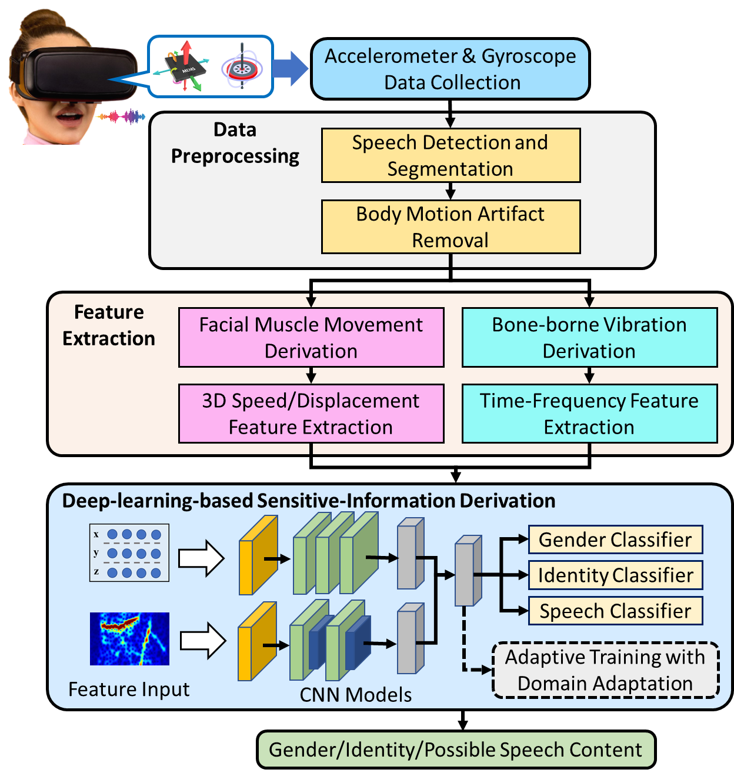
Putting All Attack Components Together
Upon detecting human speech, the malicious app segments the motion sensor data associated with speech and sends the data to a remote adversary for data processing. To deal with motion artifacts that contaminate the sensors’ readings, the authors then develop a deep regression model based on time-frequency analysis to denoise the motion sensor data.
For facial muscle movements, our attack first calculates 3D speed and displacement by applying numerical integration on the motion sensor readings. On top of that, a set of time and frequency domain features are extracted. For bone-borne vibrations, the authors explore the spectrogram as the features to capture high-frequency patterns.
Based on the facial vibration features, we develop a deep-learning-based framework for gender detection, speaker identification, and speech recognition.
Two CNN models are used to derive the feature maps of facial movements and bone-borne vibrations, and then fed the feature maps to three classifiers. If the victim’s motion sensor data and labels can be obtained ahead of time, our attack correlates the motion sensor data and the labels to train the CNN.
Otherwise, their attack utilizes the victim’s motion sensor data collected during the attack phase to adapt the pre-trained CNN model, through unsupervised domain adaptation techniques.
Notes:
Let’s put all the attack components together

Slide 18
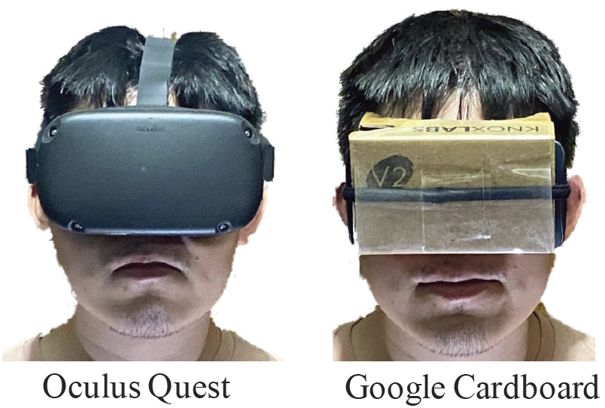
Experimental Setup
Four mainstream headsets
Oculus Quest (1000Hz)
HTC Vive Pro (1000Hz)
Google Gardboard (Nexus 6) (227Hz)
Google Caradboard (Galaxy 6) (203Hz)
Speech content
11 digits (‘oh’, 0~9)
20 Pretty Good Privacy (PGP) words
Participants and data collection
45 participants
Sound pressure levels of 67dB~73dB
6 environments across three universities
Experimental setup to capture live human speech

Slide 19
Experiments
The authors validate their attack on two standalone headsets, Oculus Quest and HTC Vive Pro, and two low-cost cardboard headsets with different smartphone models.
We collect data of 11 digits and 20 words, which can be associated with a wide range of sensitive information. Specifically, besides digits 0~9, the pronunciation “oh”, which is a synonym of digit zero, is also collected. In addition, we select 20 frequently used words from the Pretty Good Privacy word list.
The experiments involve 45 participants, and the sound pressure levels of speech are around 67dB to 73dB. The data are collected in 3 university offices, 2 residential apartments, and one outdoor environment.

Slide 20
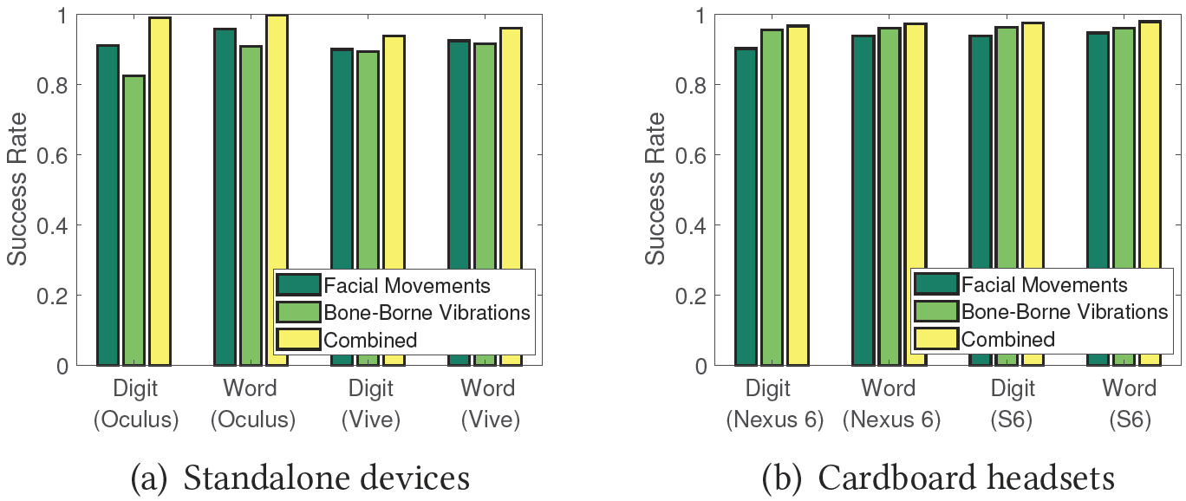
Speaker Identification
Standalone headsets
Cardboard headsets
Over 97% and 93% success rates on Oculus Quest and HTC Vive Pro, respectively
Over 94% success rate for both cardboard headsets, showing the effectiveness of the proposed attack
Notes:
For speaker identification, we find that when leveraging both facial muscle movements and bone-borne vibrations, our attack can achieve over 97% and 93% attack success rates on Oculus Quest and HTC Vive Pro, respectively.
The success rates are over 94% for both cardboard headsets, which demonstrate the effectiveness of the proposed attack.

Slide 21
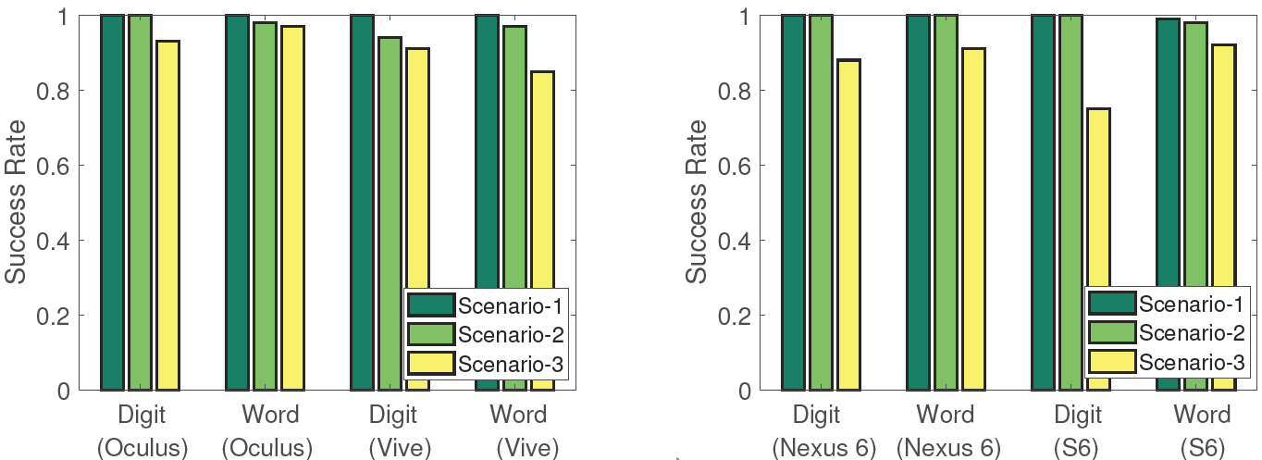
Gender Detection
Scenario-1: Attack with prior victim data
Scenario-2: Adaptive training during attack phase
Scenario-3: Real-time attack without prior victim data
Standalone headsets
Cardboard headsets
Over 99% success rate under Scenario-1 for all four headsets
Over 85% success rate for Scenario-2 and Scenario-3, which do not involve the victim’s prior data for training
Notes:
For gender detection, our attack can achieve over 99% accuracy under scenario-1, attack with prior victim data.
In addition, for scenario 2 and 3, where the adversary does not have prior data of the victim, our attack can still achieve over 85% success rate.

Slide 22
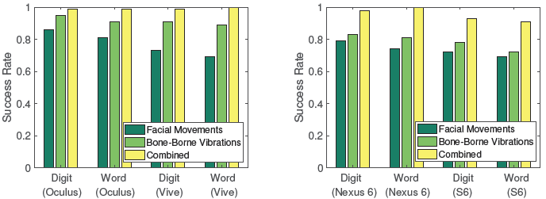
Speech Recognition (Scenario 1)
Scenario-1: Attack with prior victim data
Standalone headsets
Cardboard headsets
Over 99% success rate under Scenario-1 for Oculus Quest and HTC Vive Pro
Over 93% success rate for the two low-cost cardboard headsets with much lower sampling-rate motion sensors
Notes:
For speech recognition, it is encouraging to find that both Oculus Quest and HTC Vive Pro have over 99% success rates when using both facial muscle movements and bone-borne vibrations.
For the two cardboard headsets, even with lower sampling rates, the attack success rates are still over 93%.

Slide 23
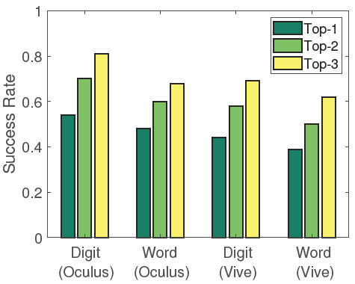
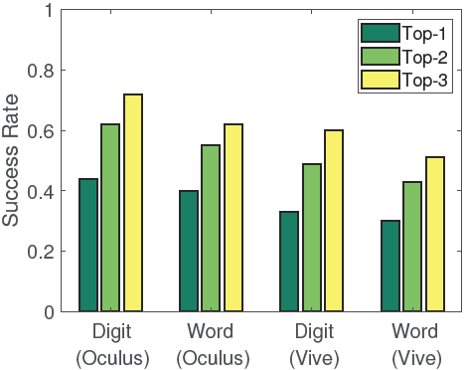
Speech Recognition (Scenario 2 &3)
Scenario-2: Adaptive training during attack phase
Scenario-3: Real-time attack without prior victim data
Scenario-2
Scenario-3
(54%, 48%) top-1, (70%, 60%) top-2 and (81%, 68%) top-3 success rates on digit recognition and word recognition on scenario-2 (Oculus)
(44%,40%) top-1, (62%,55%) top-2 and (72%,62%) top-3 accuracies for digit and word recognition on scenario-3 (Oculus)
Notes:
For more challenging attack scenarios, where the adversary does not have labels for training, the attack can achieve over 54% top-1 success rate and 81% top-3 success rates on digit recognition. The success rates are around 10% lower for HTC Vive.
For the most challenging scenario, scenario-3, their attack can still obtain 44% top-1 and 72% top-3 accuracies for digit recognition, which is much higher than the random guess accuracy of 9%.
In general, they find that scenario-2 with adaptive training leads to higher success rates.

Slide 24
Conclusions
First attack (Face-Mic) that infers private and sensitive information leveraging the facial vibrations associated with live human speech while using face-mounted AR/VR devices
Find that the speech effects in the motion sensor readings are dominated by the facial muscle movements and bone-borne vibrations
Design a series of techniques to infer the headset wearer’s gender, identity and simple speech
Demonstrate that Face-Mic can derive the headset wearer’s sensitive information with four mainstream AR/VR headsets
Notes:
They explore the first-of-its-kind attack that infers private and sensitive information leveraging the facial vibrations associated with live speech while using face-mounted AR/VR devices
They find that the speech effects in the motion sensor readings are dominated by the facial muscle movements and bone-borne vibrations
They also design a series of techniques to infer the headset wearer’s gender, identity and simple speech content.
Their extensive experiments demonstrate that the attack can derive the headset wearer’s sensitive information with four mainstream AR/VR headsets

Slide 25
Thank you!
Notes:
I am going to introduce this research article on security vulnerabilities and defenses in emerging mobile applications, including augmented reality/virtual reality, and voice assistant systems.

